Slide 1
Server-Side!

Slide 2
A Moment of Caution

Slide 3

Focus!
Node + Express Servers and Routing are two of the
MOST IMPORTANT CONCEPTS
in the ENTIRE program.
Seriously… Try to learn this now.

Slide 4

Forewarning: This is the HARD Stuff
These next units are some of the hardest to grasp.
But are also some of the most important.
This is where you go from humble HTML, CSS hackers to full-stack, employable engineers.
Bring your A-Game!!!
Don’t let this be you!

Slide 5
How to Succeed Through the Full-Stack Apocalypse
Write code in small, testable steps If you’ve written 100 lines of code and haven’t tested anything yet, it can become overwhelming to deal with bugs and syntax errors.
Pay attention to the error messages! If there are errors, don’t panic. Often, they will tell you exactly what the problem is and on what line.
Keep Googling The answer is out there, but that may mean trying different keywords and being more specific in your search.
Don’t dwell on the small details The quickest way to fall behind is to get caught up trying to understand every single line of code. Focus on the main concepts for now. The little details will fall into place later.

Slide 6

How to Succeed Through the Full-Stack Apocalypse
Lastly, be confident !!!
There is zero reason to get despondent at this point. If you’ve made it this far, you’ve proven that you have what it takes to succeed. Keep going!

Slide 7
Remember Our Mantra…
When it comes to web development…

Slide 8
Remember Our Mantra…
I know nothing.

Slide 9
So Let’s Begin…

Slide 10
Remind me again…
What is a server?
In modern web applications there is a constant back-and-forth communication between the visuals displayed on the user’s browser (frontend) and the data and logic stored on the server (backend).

Slide 11
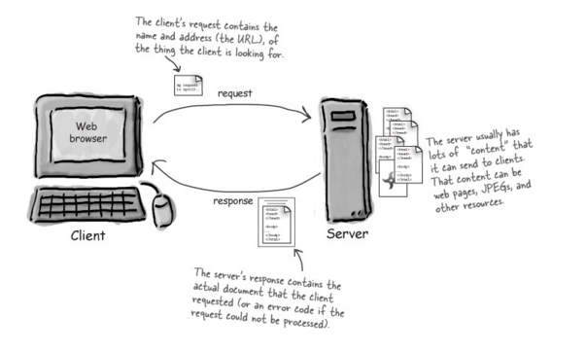
Server Definition
Server: The Machine and Code that handles requests and respond to them.

Slide 12
Remind me again…
What are examples of server-side functions?
In modern web applications there is a constant back-and-forth communication between the visuals displayed on the user’s browser (frontend) and the data and logic stored on the server (backend).

Slide 13
Server-Side Code in Action!
Visiting a URL and then being given an HTML page.
Visiting an API end-point that parse URL parameters to provide selective JSONs.
Clicking an invoice that provides a PDF report.
Image processing software that takes an image applies a filter, then saves the new version.
Google providing “results” relevant to your searches on other sites.

Slide 14
Server-Side Code in Action!
Visiting a URL and then being given an HTML page.
Visiting an API end-point that parse URL parameters to provide selective JSONs.
Clicking an invoice that provides a PDF report.
Image processing software that takes an image applies a filter, then saves the new version.
Google providing “results” relevant to your searches on other sites.

Slide 15
Remind me again…
What is a client?
In modern web applications there is a constant back-and-forth communication between the visuals displayed on the user’s browser (frontend) and the data and logic stored on the server (backend).

Slide 16
Client Definition
Client: The users’ personal machines that make “requests” of the server.

Slide 17
Bonus Question:
How do the client and server communicate with one another?
In modern web applications there is a constant back-and-forth communication between the visuals displayed on the user’s browser (frontend) and the data and logic stored on the server (backend).

Slide 18
HTTP Definition
Clients and Servers communicate back and forth using a series of understood communications defined by HTTP / HTTPs.

Slide 19
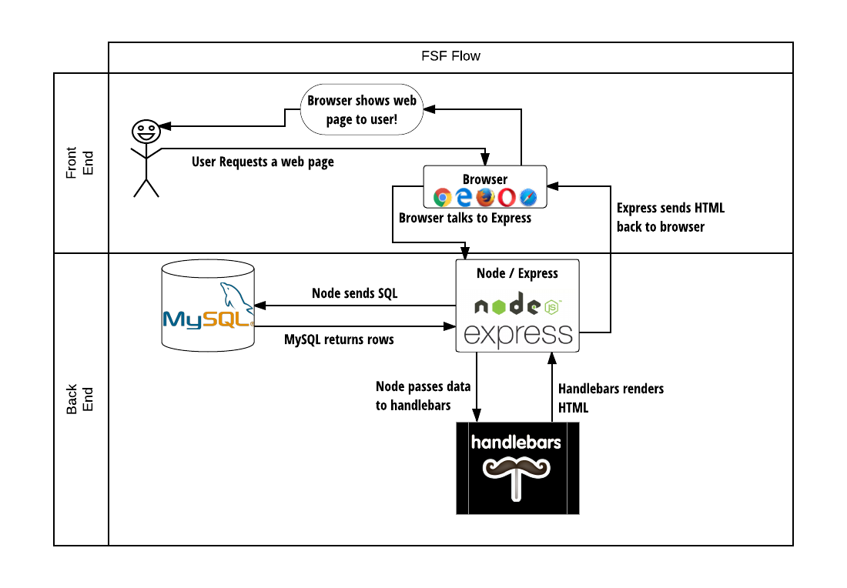
Full-Stack Development
In modern web applications there is a constant back-and-forth communication between the visuals displayed on the user’s browser (frontend) and the data and logic stored on the server (backend).

Slide 20
Digging Deep into Server

Slide 21
Visualizing Servers
Server Hardware look like large, ruggedized versions of desktop computers.

Slide 22


Visualizing Servers
These machines (and their respective code) handle all of the requests coming in from browsers accessing a website.

Slide 23
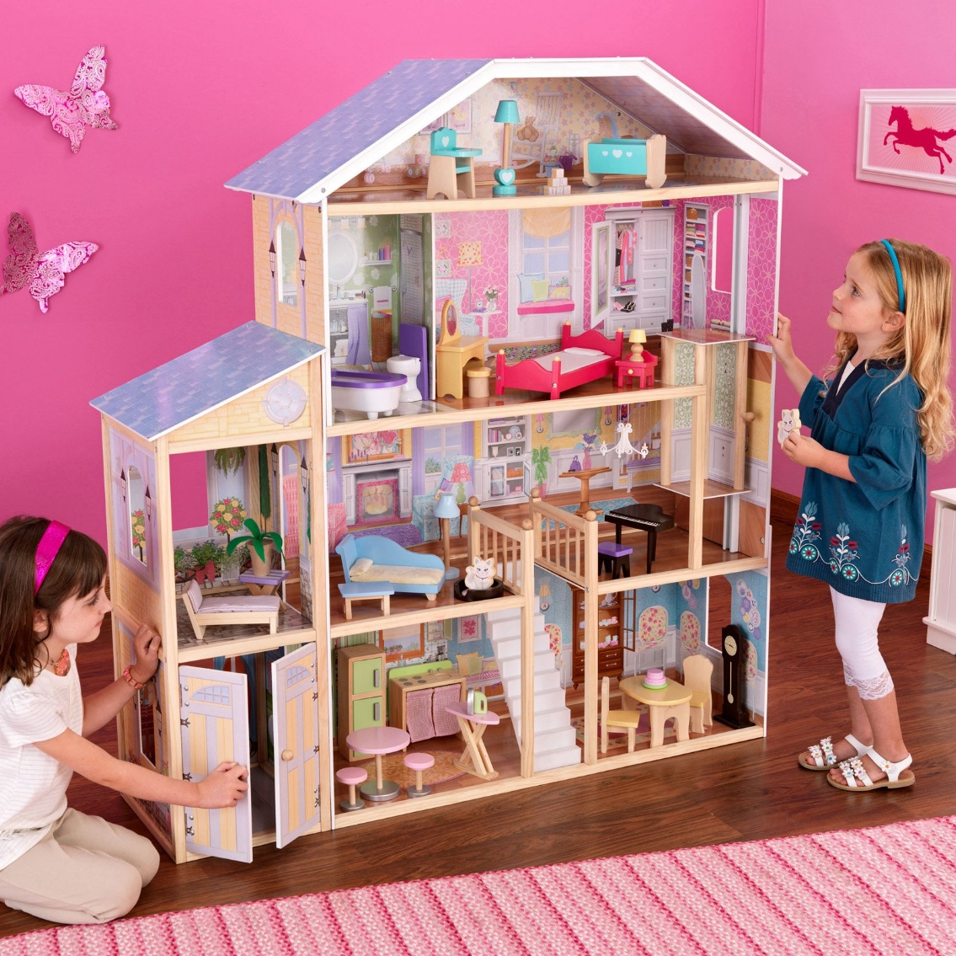
Visualizing Servers
Where does the server live?
In modern web applications there is a constant back-and-forth communication between the visuals displayed on the user’s browser (frontend) and the data and logic stored on the server (backend).

Slide 24



Where Do Servers Live?
Servers live in dedicated hardware intended to handle ALL the requests and responses of many clients.
Servers can live most often live on cloud platforms like AWS, Heroku, Google Cloud, etc.

Slide 25
Where Do Servers Live?
Servers live in dedicated hardware intended to handle ALL the requests and responses of many clients.
Servers can live most often live on cloud platforms like AWS, Heroku, Google Cloud, etc.

Slide 26
Where Do Servers Live?

Slide 27
Visualizing Servers

Slide 28


Servers During Development
localhost
Important Note:
During development our personal computers will be able to simulate both.
We will create a “local server”
And then use our browser to interact with it.
browser

Slide 29
Building a “Server”

Slide 30
Creating a Server
For our purposes, “creating a server” equates to writing the code that handles what the server will do.
It’s important to note that even though you pay for server-side hardware, you still need to create the code that goes inside.
This code you create handles things like:
Connections to the database
Handling client-side URL requests
Performing server-side processes
Authenticating user requests
Logging client requests

Slide 31
A Big Box
Server
Throughout this week… imagine your server to be a big, empty box.
We will be adding code snippets and modules to give our big, empty box the powers to do stuff in response to all the requests that come in.

Slide 32
Inside the Box: Connections
Server
We’ll add listener such that the server can “begin” listening for requests.
Listen

Slide 33
Inside the Box: Parsing
Server
We’ll give our server the ability to “parse” URLs that the user requests.
Listen
URL Parse

Slide 34
Inside the Box: Routing
Server
Then based on the URL’s keywords, our server will be able to route (or direct the flow of logic to initiate other processes)
Listen
URL Parse
Route Handling

Slide 35
Inside the Box: Sending Files
Server
This subsequent process may be to send an HTML file to be rendered or to send a JSON file to be rendered…
Listen
URL Parse
Route Handling
Send HTML
Send JSON

Slide 36
Inside the Box: Receiving Posts
Server
We may also have a new module to handle receiving user’s POST requests (i.e. the data they send the server)
Listen
URL Parse
Route Handling
Send HTML
Send JSON
Receive POSTs

Slide 37
Inside the Box: Performing Logic
Server
We may also have complex server-side logic that we want to initiate in response to user’s visiting a route endpoint or sending us data.
Listen
URL Parse
Route Handling
Send HTML
Send JSON
Receive POSTs
Server Side Logic

Slide 38
Inside the Box: And More!
Server
But it doesn’t stop there!
We may add in functionality for authentication, logging requests, connecting to databases, and so much more.
But always remember… we’re coding out these functionalities into our box!
Listen
URL Parse
Route Handling
Send HTML
Send JSON
Receive POSTs
Server Side Logic
And More!

Slide 39
Express

Slide 40
Remind me again…
What is Express?
In modern web applications there is a constant back-and-forth communication between the visuals displayed on the user’s browser (frontend) and the data and logic stored on the server (backend).

Slide 41
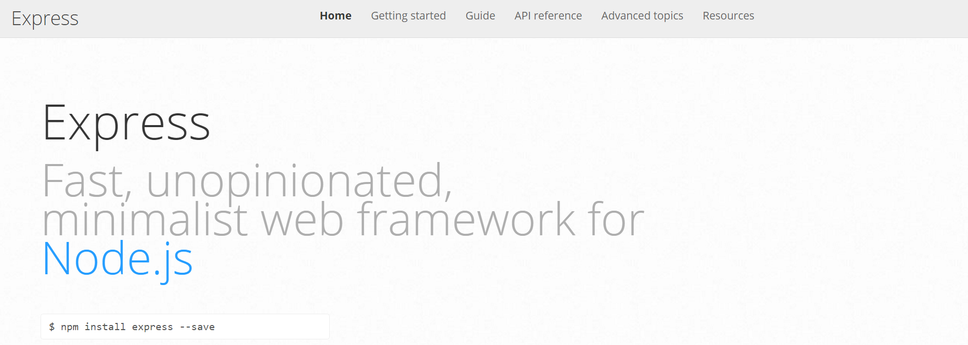
Express.JS
Web framework for node to make creating code for servers much simpler
In modern web applications there is a constant back-and-forth communication between the visuals displayed on the user’s browser (frontend) and the data and logic stored on the server (backend).

Slide 42
Remind me again…
What is a route?
In modern web applications there is a constant back-and-forth communication between the visuals displayed on the user’s browser (frontend) and the data and logic stored on the server (backend).

Slide 43
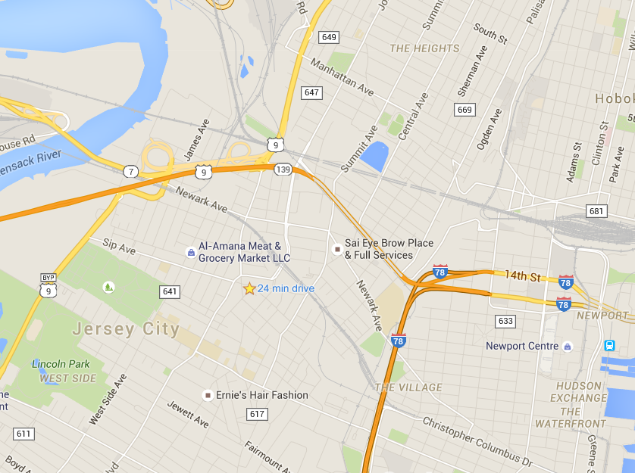
Routes = Maps
In modern web applications there is a constant back-and-forth communication between the visuals displayed on the user’s browser (frontend) and the data and logic stored on the server (backend).

Slide 44
Routes = Maps
/
User is shown the “Home” Page
/saved
User is shown the “Saved” Page
User visits a link…
User is given JSON containing all of the headline data.
/api/headlines

Slide 45
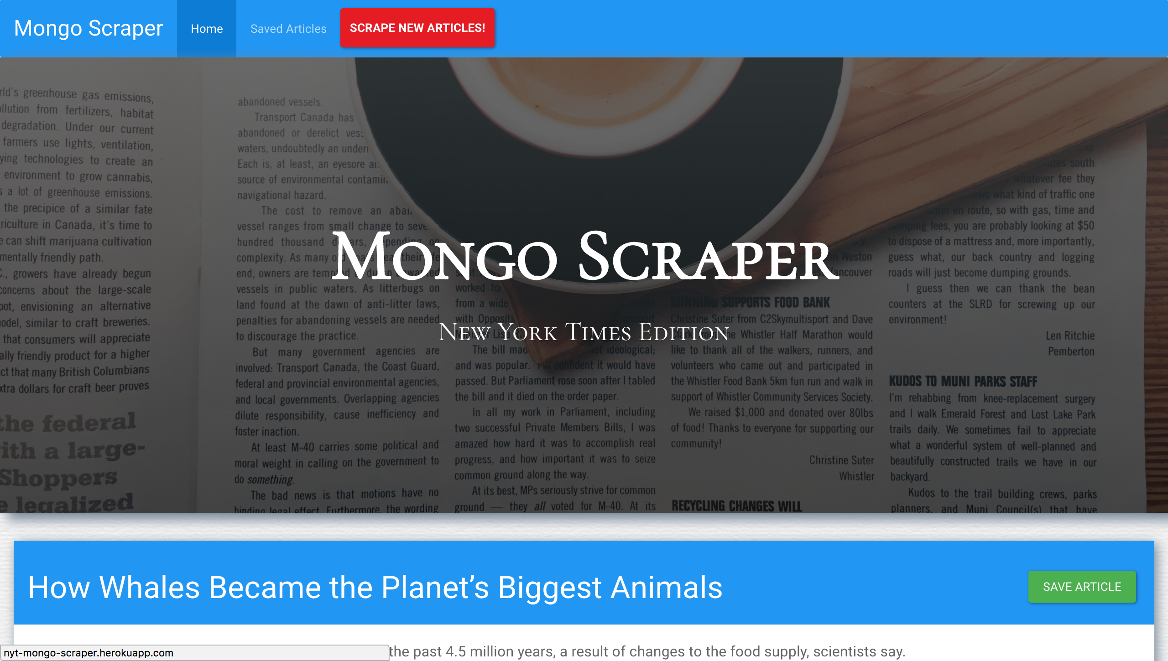
Quick Example
http://nyt-mongo-scraper.herokuapp.com/

Slide 46
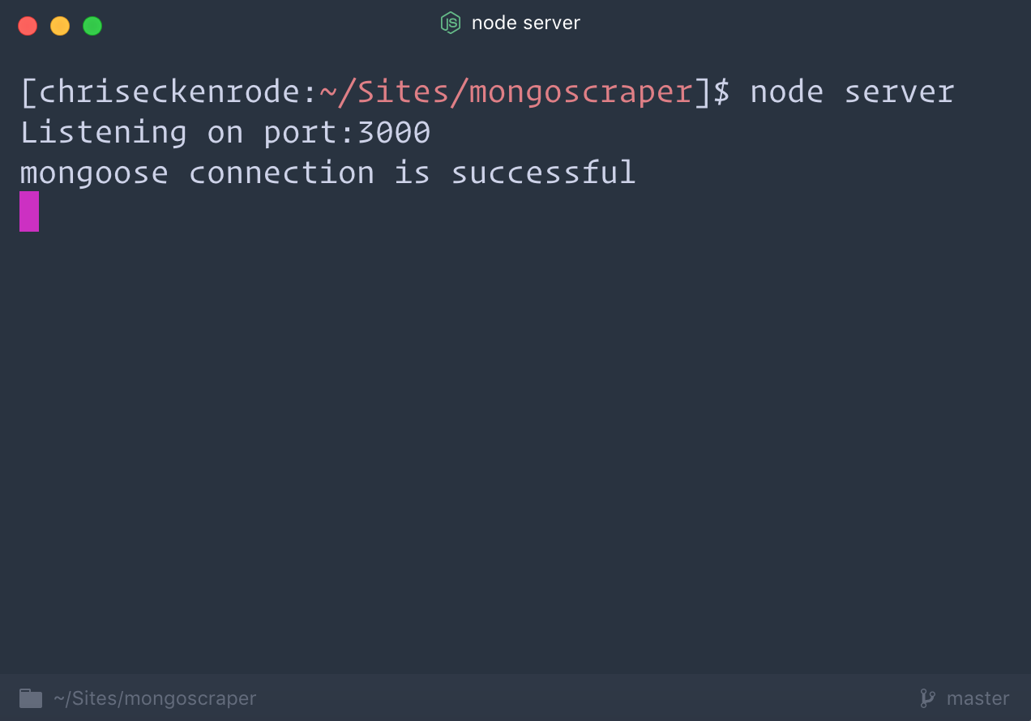
Client-Server Communication (GET)
Client Browser
Node Server
1) User visits “/” route
(GET Request)

Slide 47
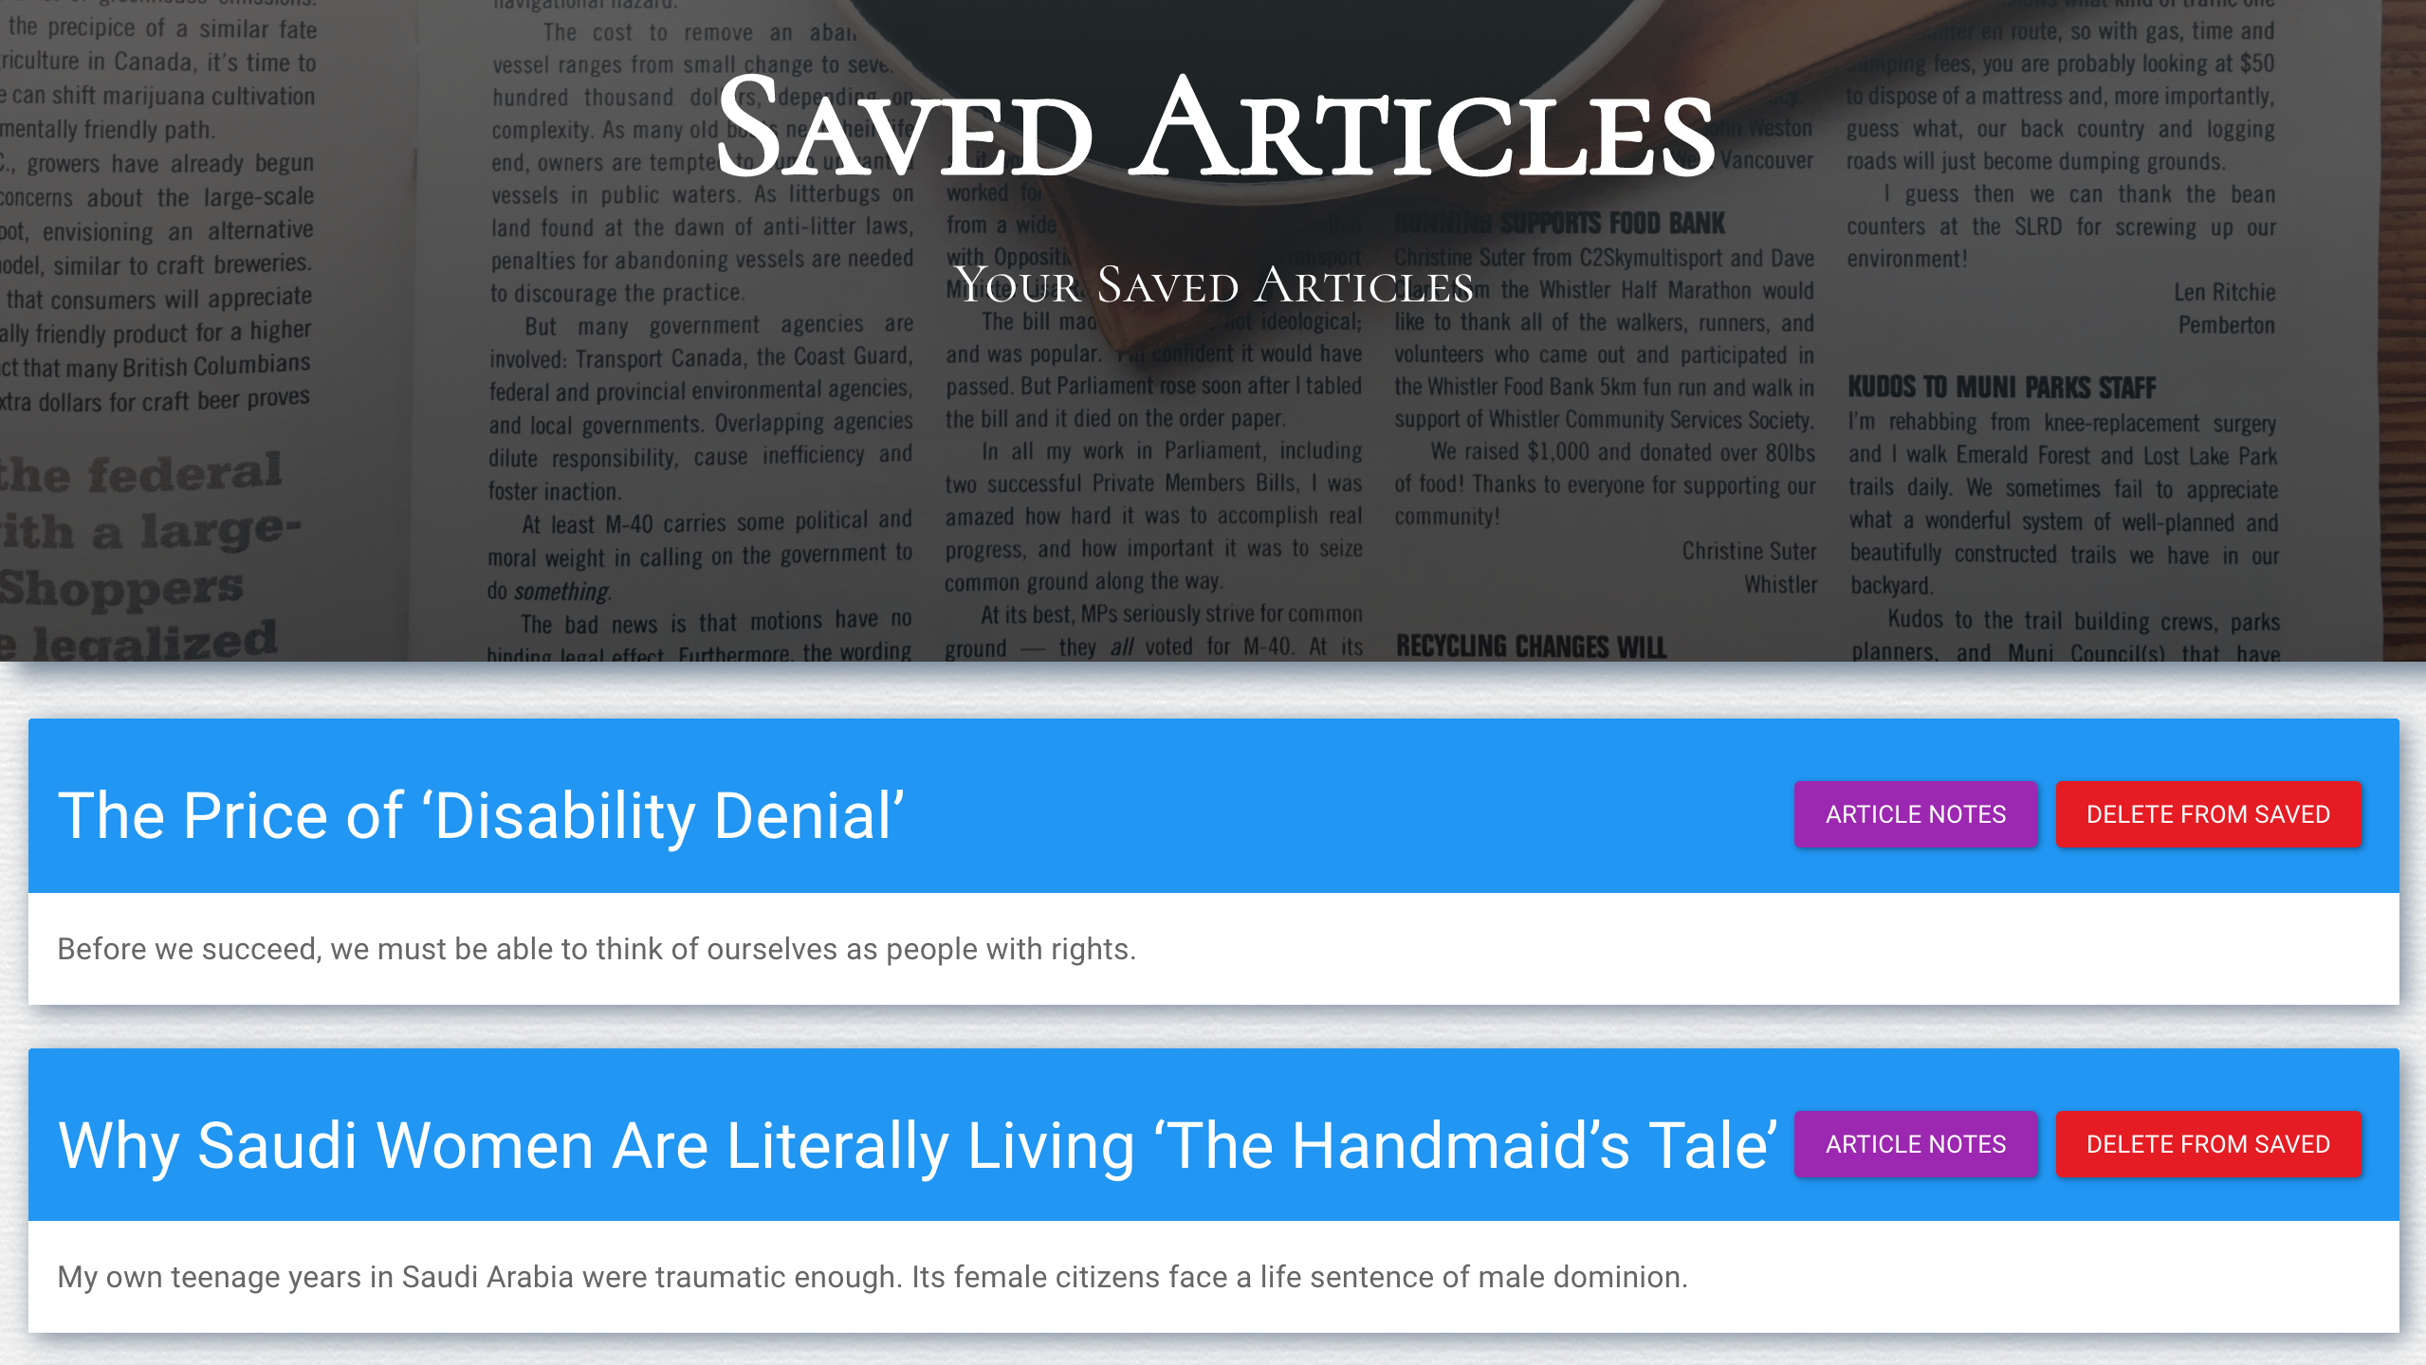
Client-Server Communication (GET)
Client Browser
Node Server
1) User visits /saved
(GET Request)
3) Server responds by providing HTML with saved articles
2) Request triggers the code in the Server route. The server then finds the relevant HTML content and data

Slide 48
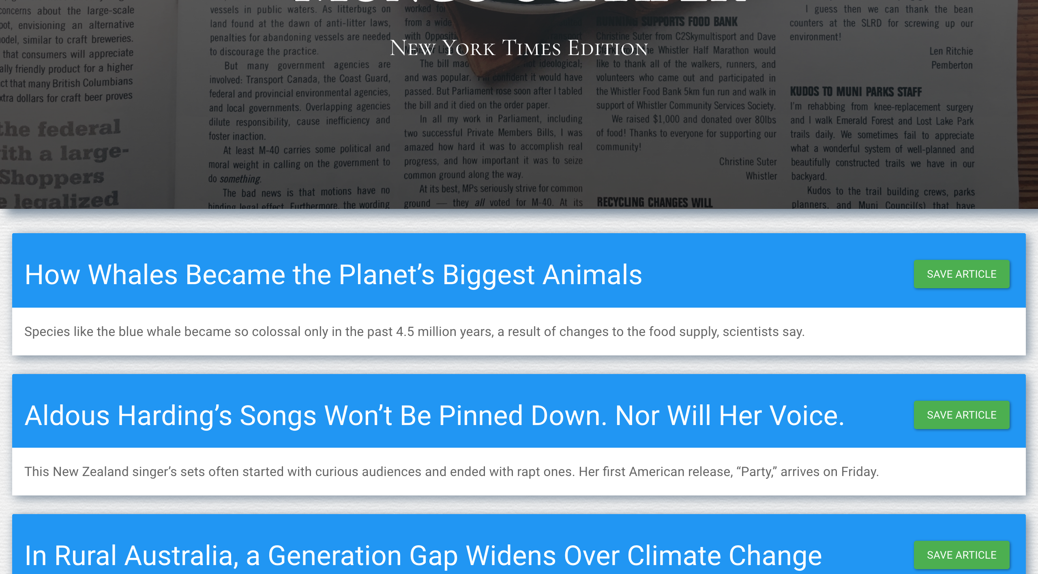
Client-Server Communication (PUT)
Client Browser
Node Server
1) User saves an article using ”api/headlines”
(PUT Request)

Slide 49
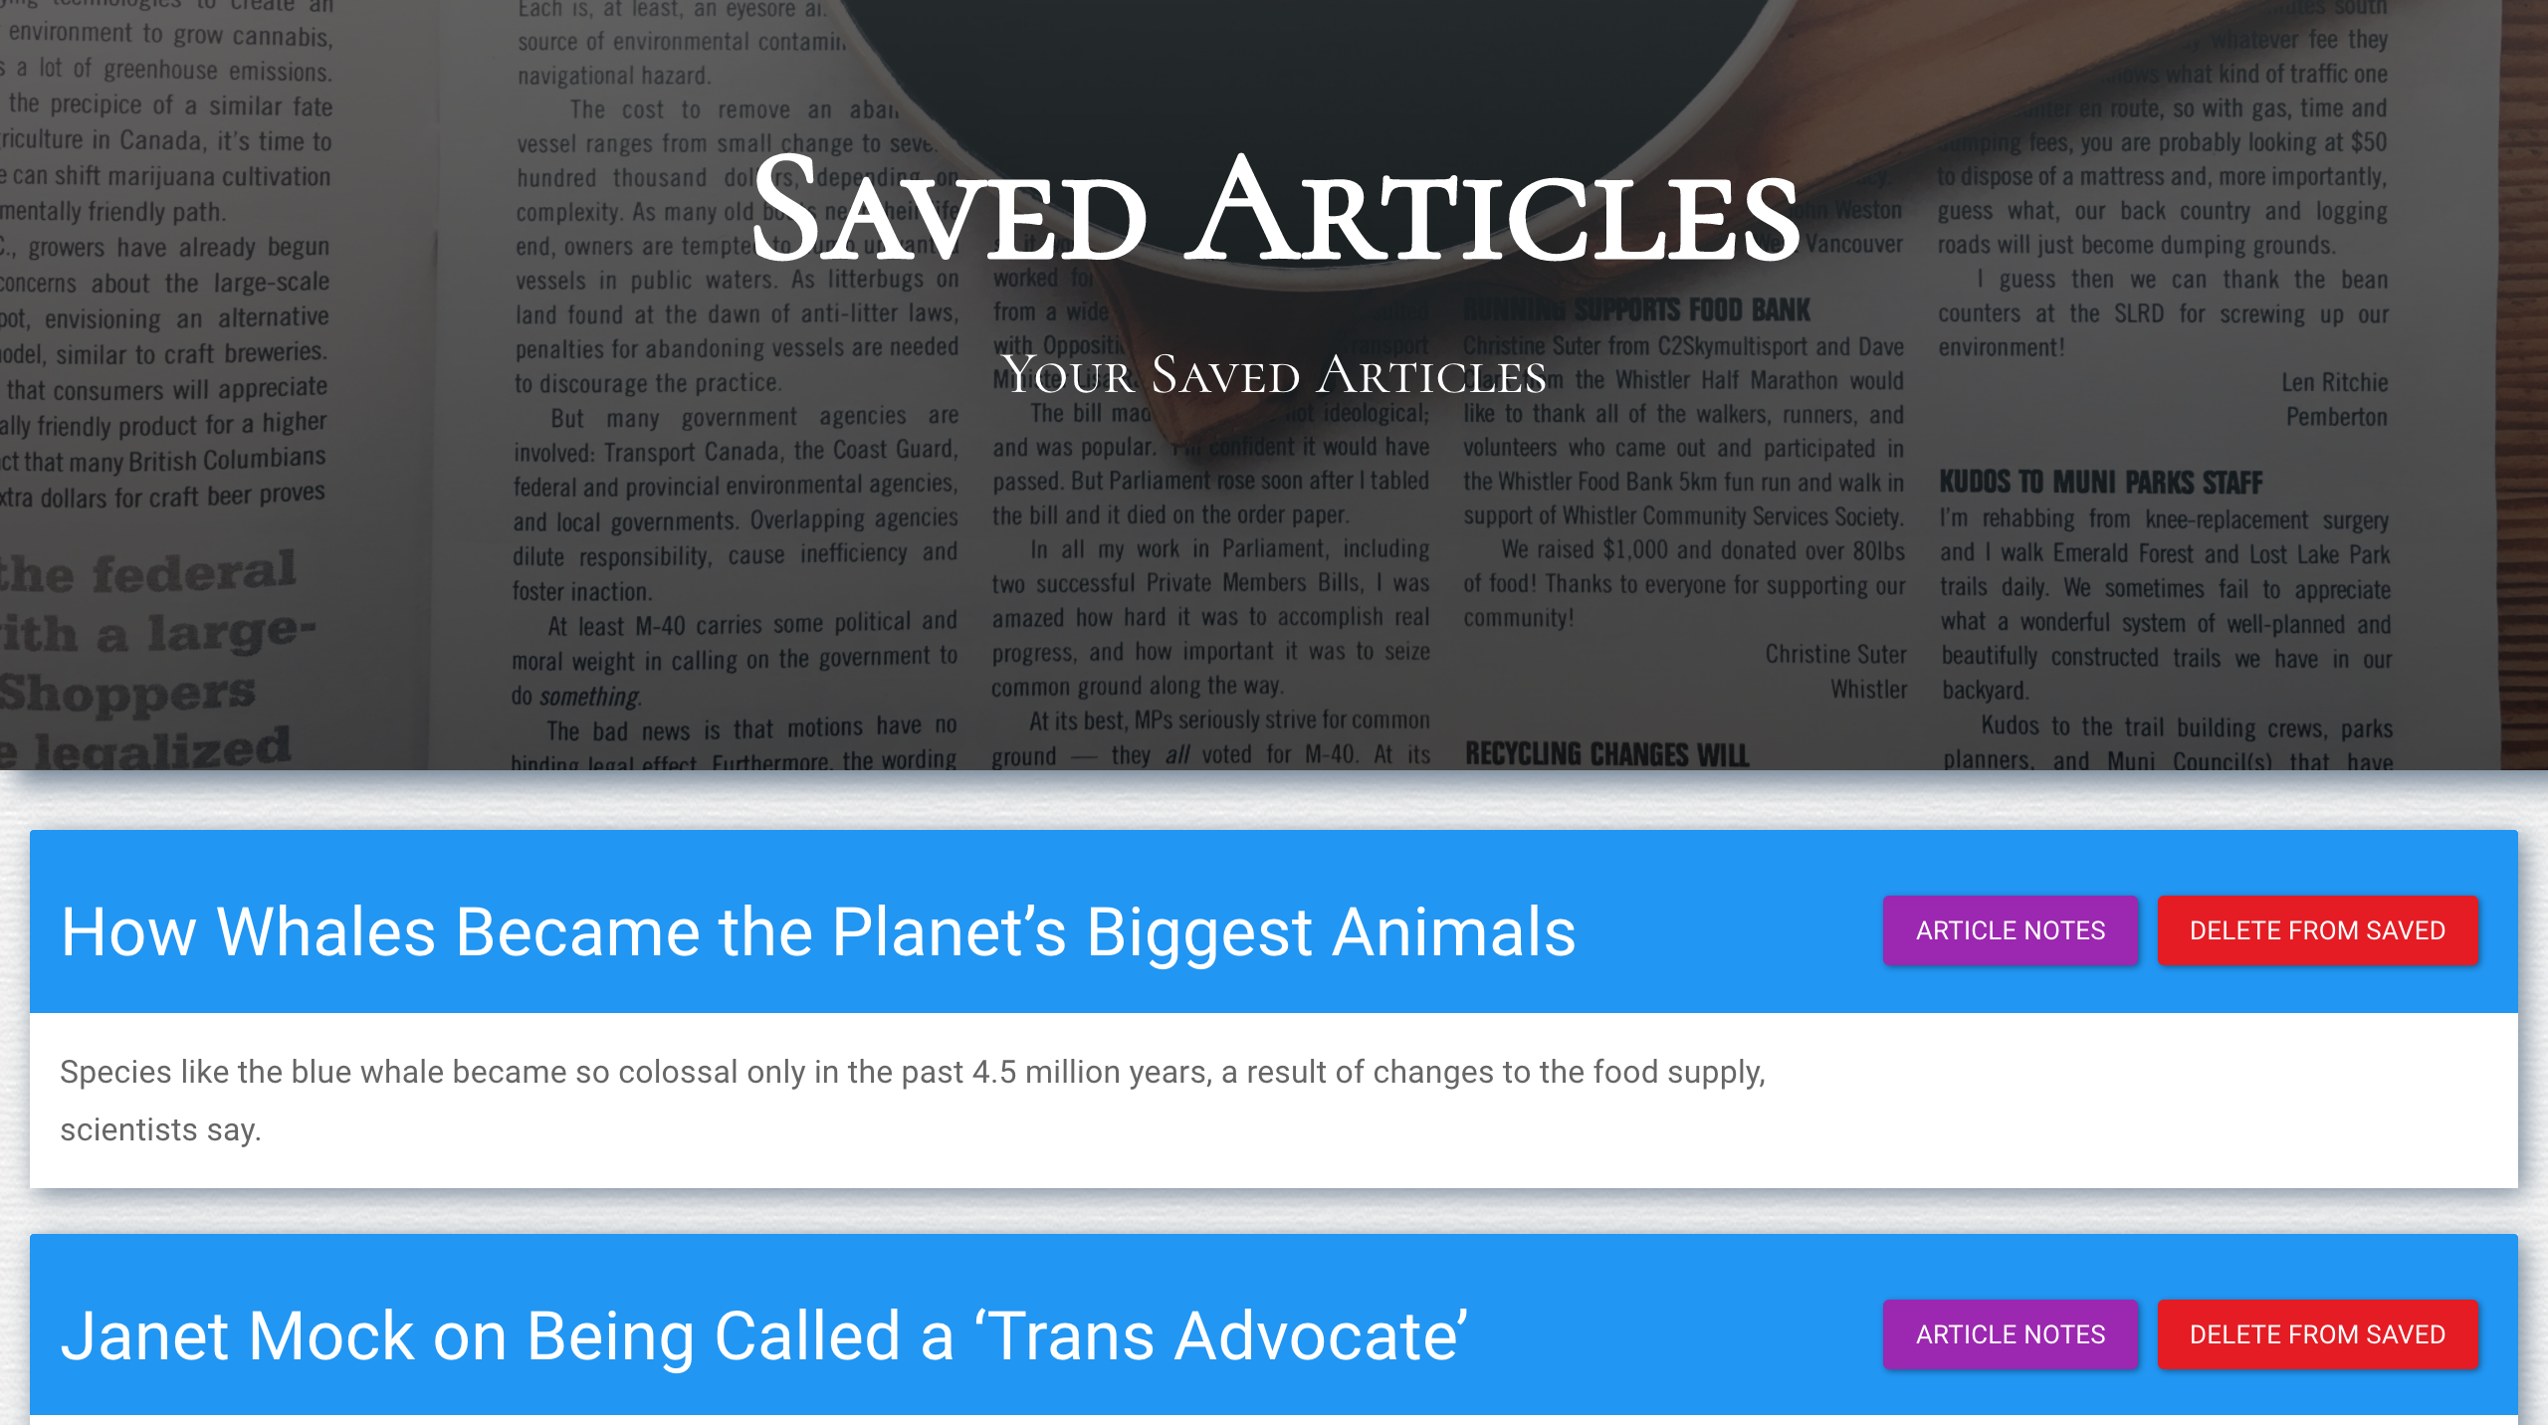
Client-Server Communication (PUT)
Client Browser
Node Server
1) User saves an article using ”api/headlines”
(PUT Request)
3) “Saved” articles are loaded on the saved page.
2) Request triggers the code in the Server route. The server then sets the article as “saved” in the database.

Slide 50
Activity Time!

